Slide 1

ICU Management System

Slide 2

Presentation Agenda
An Overview of Key Topics Covered
Introduction to the DBMS in Healthcare
ER Diagram
Advantages
Security Goals and Examples

Slide 3
Introduction
The ICU Management System is a database-based project designed to improve patient monitoring and hospital efficiency. It automates the process of recording and managing patient vitals, assigned staff, and alerts — reducing human errors and delays.
By using a structured DBMS, the system ensures data accuracy, integrity, and secure access for Admins, Staff, and Family members. It provides real-time insights, role-based access control, and transparent data management helping doctors make faster decisions and ensuring better patient care in critical situations.

Slide 4
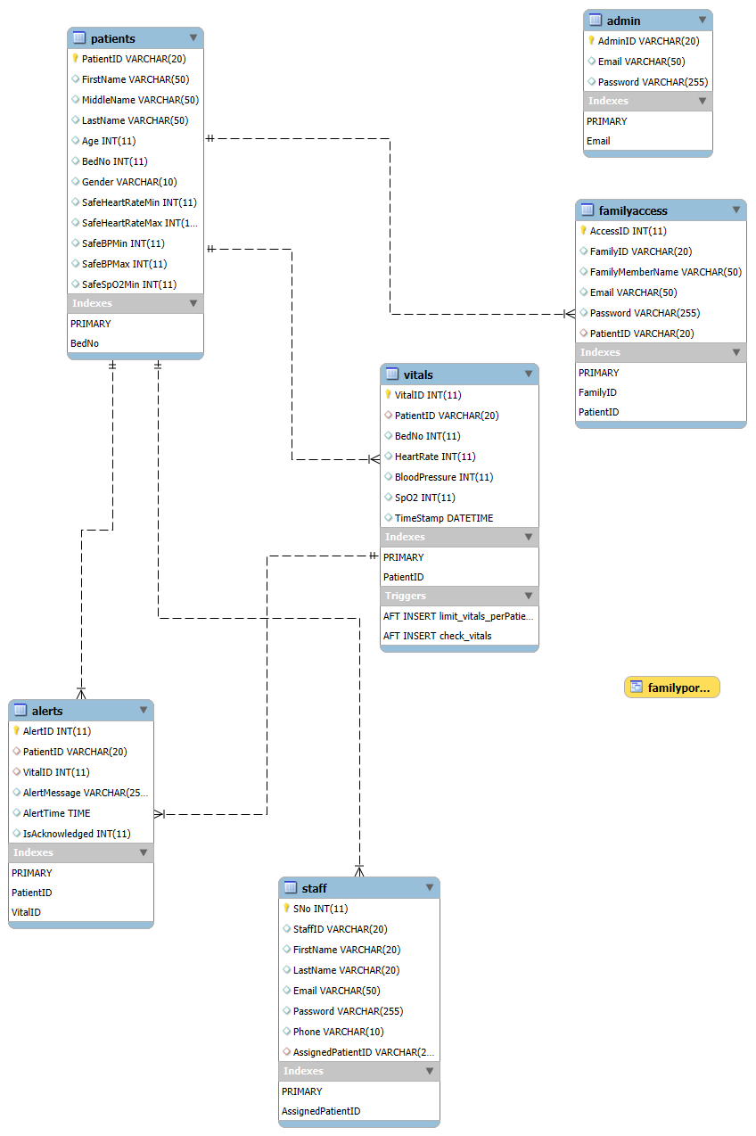
ER Diagram
4

Slide 5



User Roles in ICU Management
Family
Nurses
Administrators
Can access the real-time vitals of the patient.
Receive alerts and access vital information.
Manage resources and ensure smooth operations.

Slide 6
Advantages
24/7 Monitoring : Patient vitals are tracked continuously without relying on staff.
Early Alerts: Immediate notifications when vitals cross safe limits.
Fewer Errors: Automated logs reduce mistakes from manual recording.
Family Access: Authorized relatives can view real-time vitals securely.
Historical Data: All readings are saved for trend analysis and research.
Decision Support: Highlights patients needing urgent attention first.
Role-Based Privacy: Admin, staff, and family see only what they’re allowed.
Handles High Load: No readings are missed even with many ICU patients.
Easy Integration: Works with hospital systems, devices, or IoT wearables.
Peace of Mind: Confirms patient stability continuously for staff and family.

Slide 7
Advantages
Atomicity
Each operation (e.g., inserting vitals or acknowledging alerts) happens completely or not at all.
Triggers like check_vitals run only after a successful insert — no partial data remains.
If any error occurs (e.g., missing PatientID), the entire transaction rolls back.
Consistency
Foreign keys maintain valid relationships (e.g., Vitals.PatientID → Patients).
Triggers (check_vitals, limit_vitals_perPatient) enforce logical data rules.
Ensures vitals are within defined ranges and alerts link to valid patients.
Constraints keep schema consistent.
Old vitals auto-deletion maintains optimal table size and efficiency
Isolation
Multiple users (Admin, Staff, Simulator) can access data without interference.
MySQL’s transaction isolation prevents uncommitted data from being seen by others.
One user’s inserts or updates don’t affect another’s current view.
Eliminates race conditions and inconsistent reads during heavy data flow.
Durability
Once data (vitals or alerts) is committed, it’s saved even after crashes.

Slide 8
Security and Examples
Security Goal: Authentication
Only registered Admin, Staff, or Family can log in.
Security Goal: Authorization
Staff can see their assigned patients only; families can see their own patient; Admin sees everything.
Security Goal: Data Integrity
Prevent accidental or unauthorized modification of critical tables (like Patients or Vitals).
Security Goal: Confidentiality
Family members cannot view other patients’ vitals.

Slide 9
Thank you!

